Slide 1
CSE 543
Information Assurance & Security
(2014, Fall)
Control Techniques for the Common Password Attacks
Group 14
Madhu Meghana Talasila, Mridul Agarwal, Nikhil SunkesulaBhaskar, Omkar Deshpande, Shivam Prakash

Slide 2
Motivation
Passwords are the basic means of authentication and authorization.
In the recent past, some of the IT giants have faced the issue of password leak.

Slide 3
Goal and Scope of Study
The scope of our study involves survey of different papers that propose solutions for the following causes of password security breach.
Cause 1: Hacking attack
Cause 2: Phishing attack
Cause 3: Weak passwords
And then present a thorough analysis of present and new techniques/solutions to prevent these attacks. Thereby evaluating the identified techniques to control these causes.

Slide 4
Hacking attack
Noisy Password Scheme
Noisy Password with Patterns
Dynamic Password Authentication and Security (DPASS)
Poly PasswordHasher

Slide 5
Hacking attack (contd.)
Noisy Password Scheme
Noisy Password quadruplet -> P=<T_{S}, V, X, F>
Fixed Part (defined by the user), F= {f₁, f₂, f₃… f_{i} where 4<=i<=8}
Variable part that user enter between each alpha numeric characters until hit by terminator, V= {v₁, v₃, v₃… v_{i} where 0<=i<= n_{j}}
Terminator X= {x₁, x₂, x₃… x_{i} 4<=i<=8}
T_{s} is alphanumeric text with length S embedded between f.
No character v_{k} that belongs to V, should belong to X and vice versa.
Example- S=4, F= <2, 5, 7, 9>, X=<1, 3, 6, 8>
User can enter the following variable length password-
24592125492359456754289
The system will now look for the terminators-
24592125492359456754289
The system will now extract the characters that are located immediately after the terminators-
24592125492359456754289

Slide 6
Hacking attack (contd.)
Noisy Password With Patterns
Noisy Password quadruplet -> P=<T₁, T₂, V, F>
Fixed part F and Variable part V are same as discussed earlier.
T1 and T2 are the key stroke patterns used for defining F and V
T1= {A1, D1} where A1 - choice (F or V) and D1- duration of key strokes
T2= {A2, D2} where A2 – choice (F or V) and D2 – duration of key strokes
Feedback can be provided to indicate the user input is valid or invalid.
Example-
F= {2, 4, 6, 8}
T1= {F, 5} T2= {V, 1}
V = any subset of alphanumeric characters
1(1)3(1)5(1)7(1)2(1)2(1)4(5)4(1)2(1)6(5)9(5)0(5)0(1)8(5)0(5)6(5)0(5)7(5)7(1)7(1)9(1)9(1)9(1)3(5)1(5)2(1)3(1)4(1)3(1)4(1)4(1) Enter
The system will interpret the above example as-NNNNNN2N4NN6NNNNNNNNNNNN8NNNNNNN, where N is the noise in the password and the numbers are the actual password. System will thus extract 2, 4, 6, 8 which is the actual password.

Slide 7
Hacking attack (contd.)
Security Analysis of both the techniques
Noisy password scheme And Noisy password with patterns:
Pros
Robust against dictionary and plain text attacks.
Robust against shoulder surfing (Noisy password with patterns proved
comparatively more robust).
Robust against other hacking attacks like video recording attacks
because of dynamic nature.
Cons
Lacks ease of utilization.
Considerable amount Error rate observed in user input. Error rate
observed with feedback for noisy password with pattern is less than basic
noisy password scheme.
Time of authentication process is more as compared to common static
password technique.
Both the techniques are useful when security is more important than time.

Slide 8
Hacking attack (contd.)
Dynamic Password Authentication and Security (DPASS)
New grid for every time a user tries to logs in
Easy to remember pattern for user
In case of low end server – grids are stored and repeatedly used

Slide 9
Hacking attack (contd.)
Dynamic Password Authentication and Security (DPASS)
Limitations
If Grid id compromised attacker can sniff large amount of authentication packets for same Grid id from the user and guess the pattern as there is only change of complex character.

Slide 10
Hacking attack (contd.)
PolyPasswordHasher
Advantages
Efficient in terms of memory, disk space and CPU time when compared to existing techniques.
Uses SHA256 with salt for password storage & Shamir secret value for dividing & storing the individual shares separately.

Slide 11
Hacking attack (contd.)
PolyPasswordHasher
Limitations
Threat model assumes lot of things like attacker cannot read memory on server etc.
Requires certain threshold users to be strong enough
If all threshold accounts choose weak passwords ?
Password shares cannot be recreated if the threshold user forgets the password.

Slide 12
Phishing attack
Spam Filter
Anti-Phishing toolbar
Password Protection Mechanism
Moody Keyboard
One Time Password (OTP)

Slide 13
Phishing attack (contd.)
Spam Filter
Spam Filter filters out the spam mail consisting links of fraudulent website.
This is achieved by training of classifiers.
Disadvantage
Filters relies on training of classifier by the user.

Slide 14
Phishing attack (contd.)
Anti-Phishing toolbar
Antiphishing Toolbars predicts whether a website is genuine or fraudulent .
Relies on Whitelist, Blacklist and heuristics which see the difference between the URL used.
Disadvantage
Difficult to maintain a huge list for Whitelisted and Blacklisted sites.
Spoofguard which used heuristics together with whitelist is practical and efficient when focused on a particular sector only (e.g. Banking). Otherwise number of whitelisted site will be very large.
Some example of AntiPhishing Toolbars are Google Safe Browsing, McAfee Site Advisor, Spoofguard, Antiphish.

Slide 15
Phishing attack (contd.)
Password Protection Mechanism
Mechanism in which toolbars hash master password to prevent providing credential information to phishers.
PwdHash++ used MD5 to hash the master password with the domain name of the website.
Hashing with salt value technique used SHA-1 to hash the master password with a salt.
SHA-1 is more secure than MD5 since SHA-1 performs more round to derive 80 word message and also no such potential collision attack has been developed for SHA-1 compared to MD5.
Hashing with salt value is better than PwdHash++
Disadvantage
Prone to shoulder surfing
Toolbar needs to be installed on every system through which user accesses website for which hashed password was used.

Slide 16
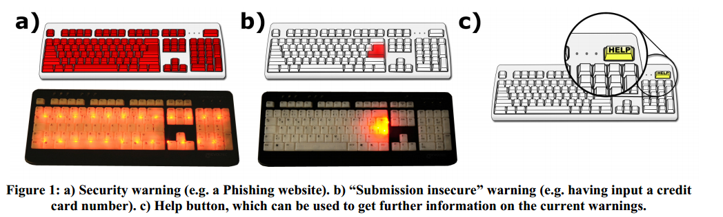
Phishing attack (contd.)
Moody Keyboard
A keyboard with multi color LED light and a HELP button which warns user through ambient security notification.
Disadvantage
Low accuracy rate.
De Luca, A., Frauendienst, B., Maurer, M., and Hausen, D. 2010. On the design of a “moody” keyboard. In Proc. DIS ’10. Aarhus, Denmark, August 16 - 20, 2010.

Slide 17
Phishing attack (contd.)
One Time Password (OTP) – Delivery Methods
text messaging,
mobile phones,
proprietary tokens,
web based methods(using IM service), and
paper

Slide 18
Phishing attack (contd.)
One Time Password (OTP) – Benefits of using IM
delivers messages in real time,
almost ubiquitous,
cost effective,
infrastructure is already available on the internet,
downloading the client side program and obtaining a user account are free of charge.

Slide 19
Phishing attack (contd.)
One Time Password (OTP) - Mechanism
OTP using Instant Messaging (IM) mechanism involves two processes:
a registration process, and
a login process.

Slide 20
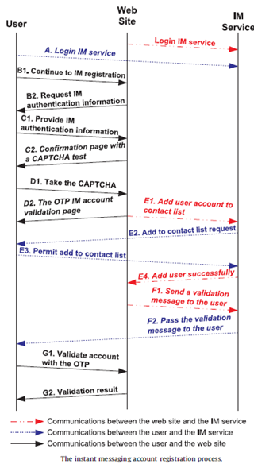
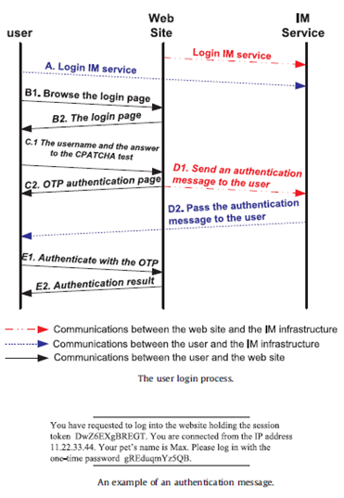
Phishing attack (contd.)
One Time Password (OTP) - Mechanism
C.-Y. Huang et al. / Journal of Network and Computer Applications 34 (2011) 1292–1301

Slide 21
Phishing attack (contd.)
One Time Password (OTP) – Security Analysis
Mutual authentication
Website authenticates user by asking to enter OTP which is already assigned by the website.
Compromising the proposed solution
There are 3 components – user’s website account and IM account, website’s IM account; Attacker needs to know the hidden relationship between these 3 components.
Authentication in an untrustworthy environment
Access the IM account through the trusted device to obtain the OTP.
Man In The Middle attack.
We have already made an assumption that the primary channel used to deliver login name is secure; Most web browsers and commercial websites use the SSL protocol to encrypt HTTP traffic; Eavesdropper cannot associate OTP with user’s web account name.

Slide 22
Phishing attack (contd.)
One Time Password (OTP) – Security Analysis
Security enhancements for instant messaging services
Can be done by encrypting the instant messages; having a customized interpretation of customized messages; block messages from unknown users.
IP-spoofing attack
Difficult to occur as the primary communication channel is encrypted; Attacker has to be someone using the same IP or some sort of man in the middle.
Anti-phishing for instant messaging services
Most IM services have their own platform-dependent IM clients because of which there are lower chances of attacker phishing an IM account; To ensure a successful attack, the phisher must – insert a crafted IM client into the user’s PC.

Slide 23
Weak Passwords
The Password Problem
Graphical Password

Slide 24
Weak Passwords (contd.)
The Password Problem
The two fundamentally conflicting requirements:
Passwords should be easy to remember, and the user authentication protocol should be executable quickly and easily by humans.
Passwords should be secure, i.e., they should look random and should be hard to guess; they should be changed frequently, and should be different on different accounts of the same user; they should not be written down or stored in plain text.
LTM – Interference and decay
What people do?
Decrease memory load at the expense of security – Choose weak passwords
(Wiedenbeck, Waters, Birget, Broditskiy & Memon, 2005).

Slide 25
Weak Passwords (contd.)
Graphical Passwords
An image would appear on the screen, and the user would click on a few chosen regions of it. If the correct regions were clicked in, the user would be authenticated.
Types of Graphical Passwords Techniques:
1. Recognition Based Techniques
Déjà vu (Hash Visualization Technique)
Pass-Objects (Deals with shoulder surfing)
Passfaces
2. Recall/ Cued-Recall Based Techniques
Passlogix During authentication, user has
Draw-A-Secret (DAS)
PassPoints
3. Hybrid Systems

Slide 26
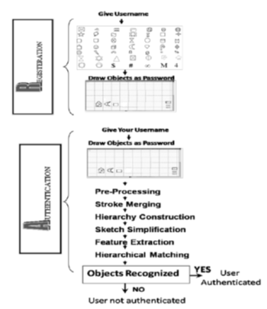
Weak Passwords (contd.)
Hybrid System
Uses two graphical password techniques / Graphical password & text password
Advantages:
Resistant to all attacks on graphical passwords
Brute Force
Dictionary
Software Engineering
Disadvantages:
Inherent weakness of graphical passwords
Poor vision, poor mission control
Standard input device (Keyboard)
Slow – Normalization and Matching
Wazir Zada Khan, Mohammed Y Aalsalemand Yang Xiang. “A Graphical Password Based System for Small Mobile Devices”IJCSI International Journal of Computer Science Issues, Vol. 8, Issue 5, No 2, September 2011.

Slide 27
Conclusion
Noisy Password technique lacks in terms of ease of utilization. Authentication process can take considerable amount of time if users have no basic prior knowledge and thus can result in significant amount of error rate while inputting credentials.
Poly PasswordHash assumes that attacker cannot access arbitrary memory in server which is not reasonable. Also need minimum number of threshold users to keep password shares safe.
In DPASS, finite no of grids are stored in case of low capacity servers which cause grids to be repeated and make it more prone to attacks. Also this technique is not safe if the Grid ID is compromised.
Password Hashing Mechanism is prone to shoulder surfing and is cumbersome to use.
Hybrid Mechanism of Graphical Passwords is limited to handheld devices as it lacks implementation with standard input device - “keyboard” and takes more time for authentication process.

Slide 28
Conclusion
On comparing the before mentioned techniques with respect to –
attacks (like Dictionary attack, brute force attack, shoulder surfing, social engineering),
human factors (like error rates, ease of utilization, authentication time),
technical factors (like storage space, query retrieval time and accuracy of the system),
OTP proves to be comparatively more competent and efficient.
The only drawback with this solution is the attackers targeting the IM accounts, but it is relatively easy to detect such types of attacks with the existing anti-phishing techniques (such as list based and heuristic based methods).

Slide 29


